Slide 1

Testing & Verification of Digital Circuits Final Project - GOST 28147-89
Marios Karagiannis, University of Thessaly

Slide 2
Overview of the GOST standard
GOST stands for “Gosudarstvennyy Standard, which translates to “Government Standard”
It is a set of technical standards used in the former Soviet Union, and currently in Russia (and, to a lesser extent, other post-Soviet countries)
The block cipher GOST 28147-89 is one of these standards
Other standards include:
GOST 27975-88: Programming Language ALGOL 68
GOST 10859: A character set that included non-ASCII symbols
GOST 7396: A standard for power plugs

Slide 3
Historical overview of GOST 28147-89
GOST 28147-89, commonly referred to as GOST, or Magma, is a symmetric key block cipher developed in the 1970s by the Soviet Union
It was initially kept secret, but after the dissolution of the USSR, it was released to the public in 1994
It was considered as the Soviet alternative to the DES algorithm, used in the United States
The two algorithms share similarities in their structure

Slide 4
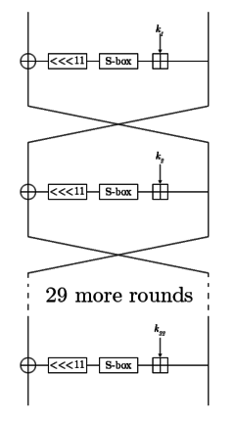
Functional overview of GOST
GOST is a symmetric block cipher
Meaning that it uses the same key for encryption and decryption
It uses 64-bit blocks of data and a key length of 256 bits
The encryption process requires 32 rounds
Using substitution and permutation operations to transform the data
The S-Boxes it uses take a 4-bit input and produce a 4-bit output

Slide 5
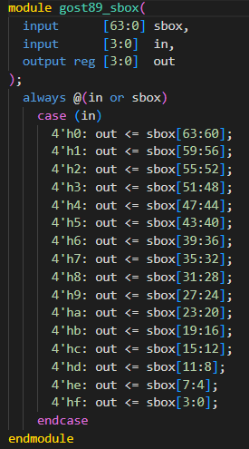
GOST Sbox
The sbox (or substitution box) takes 4 bits as input, and a 64-bit “sbox”, and returns as output a 4-bit set of the sbox input, depending on the value of the 4-bit input
So, the 4 input bits are replaced with another set of 4 bits
In Verilog, this functionality is achieved with a simple combinational always block and a case statement
Note: Using non-blocking assignment is not recommended for a combinational always block. We fix that later along with the SV additions

Slide 6
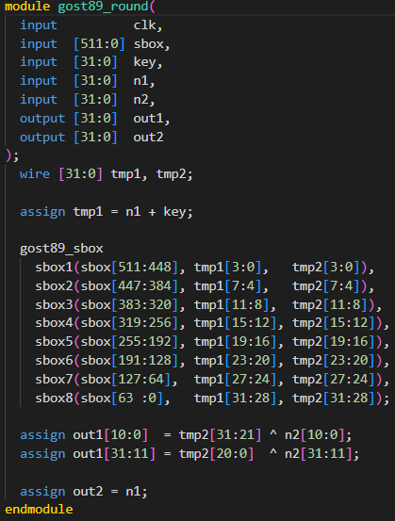
GOST Round
A GOST round is a sequential circuit that takes as I/O:
Input:
A 512-bit sbox
A 32-bit key
Two 32-bit buses, n1 and n2
Output:
Two 32-bit buses, out1 and out2
It uses two 32-bit wires
Tmp1, tmp2
Tmp1 = n1 + key
It calls the previous sbox module 8 times, replacing the current value of tmp1 and storing it in tmp2
Out1 is computed using the XOR operation between parts tmp2 and n2
Out2 receives the value of n1
Maybe pointless

Slide 7
GOST Round
In other words, the Round module performs key mixing, S-box substitution and XOR operations on the input data to produce encrypted or decrypted output blocks for each round of the encryption or decryption process

Slide 8
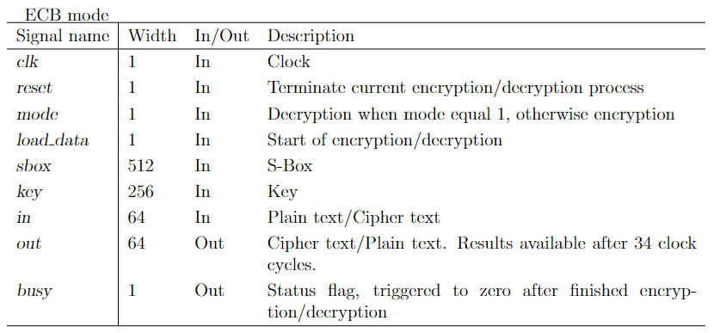
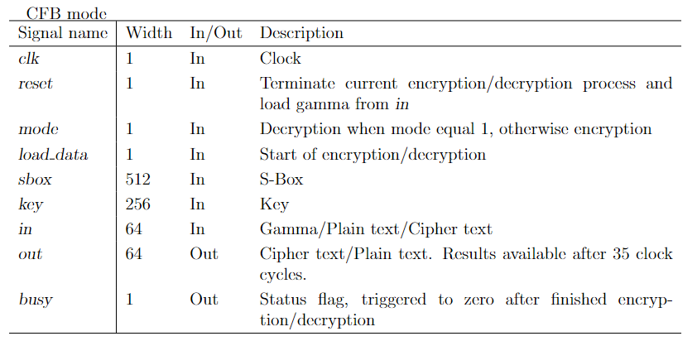
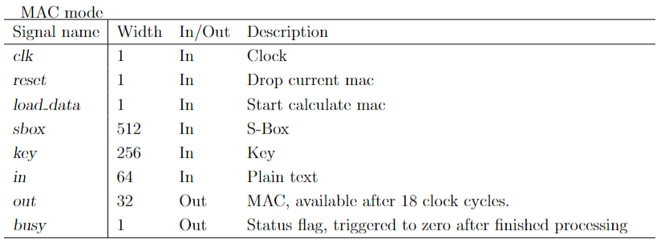
GOST Encryption Modes
This GOST circuit comes with three encryption modes
ECB(Electronic Codebook)
CFB(Cipher Feedback)
MAC(Message Authentication Code)

Slide 9
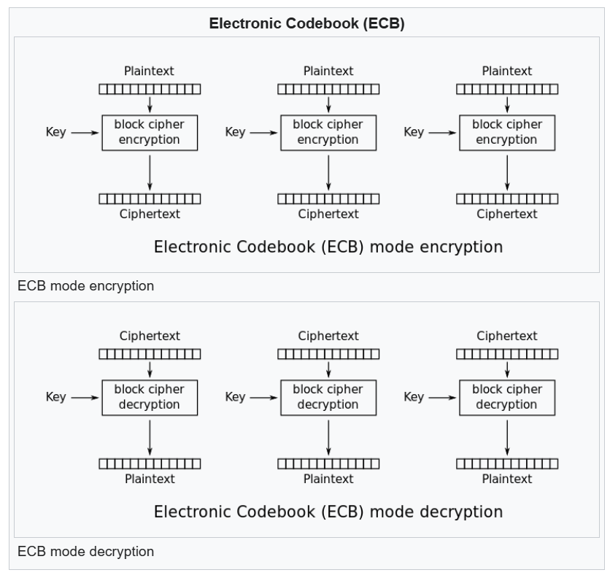
ECB = Electronic CodeBook
ECB is a simple encryption mode that works by dividing the plaintext into blocks of fixed size and encrypting each block separately
It has a major drawback: Identical blocks of plaintext will result in identical blocks of ciphertext
It is, therefore, not recommended for use

Slide 10
ECB – Electronic Codebook
The Verilog file for ECB has three modules:
An encryption module
A decryption module
A module that can do both operations depending on an input flag
The functionality of the encryption and decryption submodules is exactly the same as their respective functionality in the third module
So, only the encryption and decryption modules will be presented, but the same functionality and changes can be applied to the third module

Slide 11
ECB – Electronic Codebook
The ECB modules have, as I/O:
A clock
A reset (synchronous, as will be shown in the Verilog code)
A mode (not for the separate encryption/decryption modules)
Load_data (signals the start of encryption/decryption)
The 64-bit text as input (plain text for encryption, cipher text for recryption), and as output (the opposite)
The 512-bit sbox
The 256-bit key
A busy signal

Slide 12
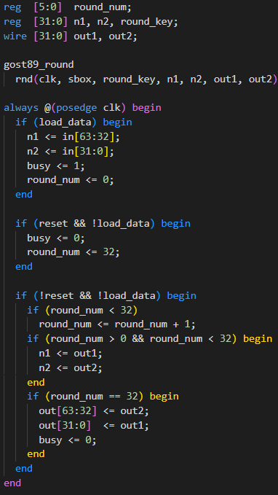
ECB – Electronic Codebook
A huge part of the code is the same for the encryption and the decryption
Inside the always block
The first block is activated when load_data is active, and it starts the encryption/decryption, filling the 32-bit regs n1 and n2 with half the text each
The second block is activated with reset, and it resets the output flag busy and the round num
The third block is activated after the load_data signal has arrived. It increments the round_num counter every clock cycle, and transfers the values of out1,out2 (which are used as output in the round module) to n1,n2 (which are used as input in the round module). When 32 rounds have been completed, the values are transferred to the out port

Slide 13
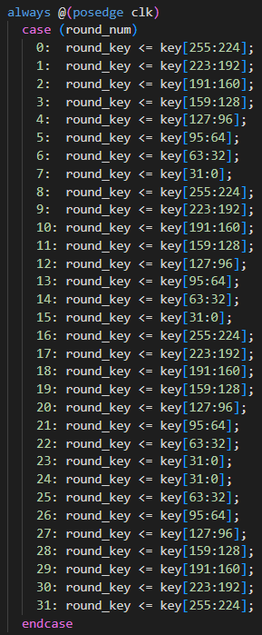
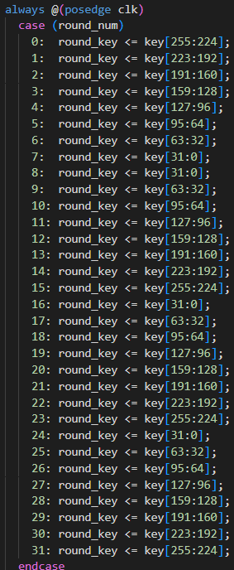
ECB – Electronic Codebook
There is one more sequential always block, which is different between the encryption (left) and the decryption (right).
The reg round_key, which is used as input in the round module, has its values transferred from the key input
The difference between the two modules is that, in some rounds, the round_key receives a different word from the key
Namely, in rounds 8-23

Slide 14
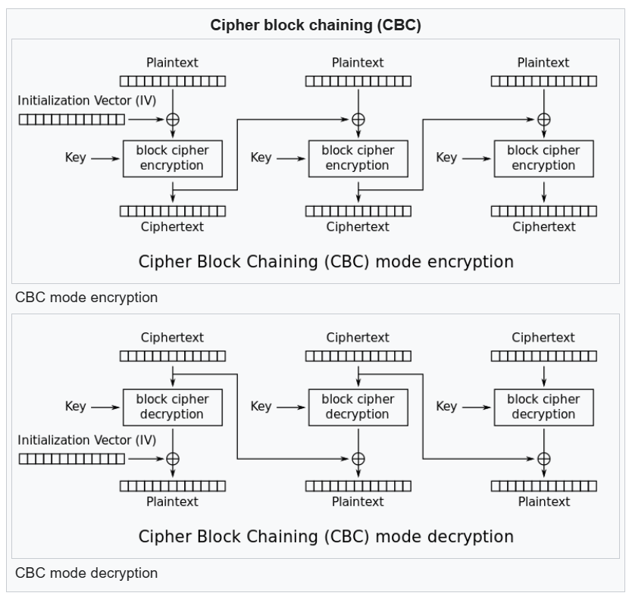
CFB – Cipher Feedback
CFB is a mode of operation, in which a plaintext is XOR’ed with the output of the encryption of the previous block
It solves ECB’s problem of producing identical blocks, but is less parallelizable, as it is sequential
Like ECB, the Verilog file comes with three separate modules that have the same functionality for the encryption/decryption operations

Slide 15
CFB – Cipher Feedback
The CFB modules have, as I/O:
A clock
A synchronous reset
A mode (not for the separate encryption/decryption modules)
Load_data (signals the start of encryption/decryption)
The 64-bit text as input (plain text for encryption, cipher text for recryption), and as output (the opposite). Also expressed as gamma (the feedback value)
The 512-bit sbox
The 256-bit key
A busy signal

Slide 16
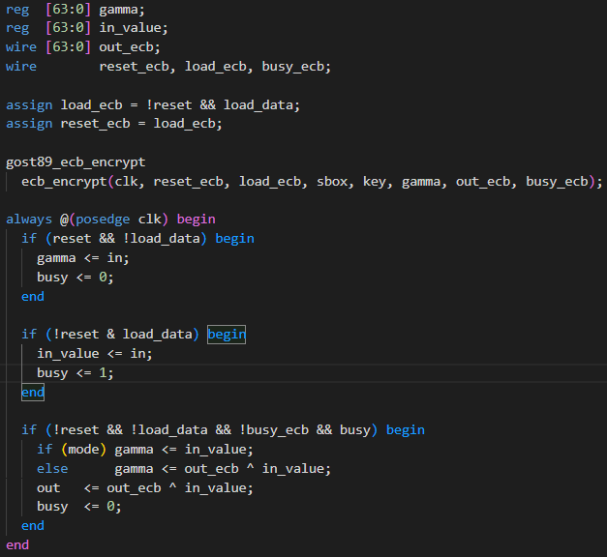
CFB – Cipher Feedback
This module uses the ecb module to encrypt/decrypt the gamma value at each round
At reset, gamma receives the value in (corresponds to the initial vector)
When the load_data signal is activated, the reg in_value receives the value from the in input
The rounds change inside the ECB module, and their status is communicated to the top module via the busy_ecb status

Slide 17
CFB – Cipher Feedback
When a round is not active, the gamma reg receives a value, depending on the mode (encryption or decryption), and the out and busy ports also receive values
If the mode is encryption:
Gamma receives the XORed value
If the mode is decryption:
Gamma receives the input value
Out receives the XORed value
Same as gamma for the encryption
Different to gamma for the decryption

Slide 18
CFB – Cipher Feedback
CFB comes with one extra Verilog file, which includes a pipelined module
However, for the sake of simplicity, this module will not be explained in this presentation
It is, however, available along with the other Verilog files
It will undergo the necessary changes to turn into the System Verilog format

Slide 19
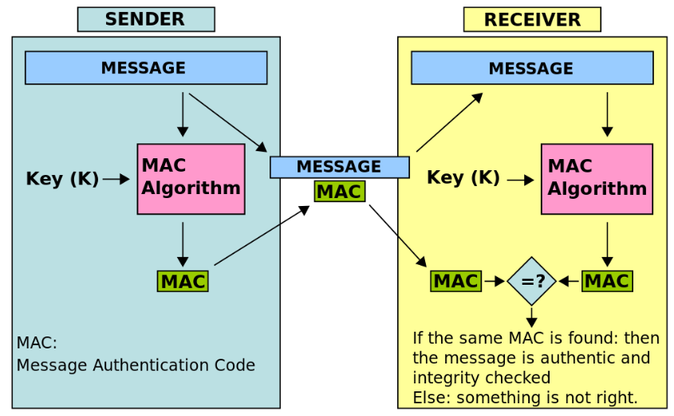
MAC – Message Authentication Code
MAC is a technique used to verify the integrity and authenticity of a message.
It is not an encryption/decryption mode, like the previous two, but is used alongside encryption to provide assurance

Slide 20
MAC – Message Authentication Code
Unlike ECB and CFB, there is only one MAC module
Its inputs and outputs are:
A clock
A synchronous reset
Load_data (signals the start of the MAC calculation)
The 64-bit text as input
A 32-bit MAC as output
The 512-bit sbox
The 256-bit key
A busy signal

Slide 21
MAC – Message Authentication Code
MAC uses the round module
Its key input is the 32-bit reg round_key, which receives a 32-bit word from the key input every clock cycle (see last always block)
MAC uses a counter that counts 17 cycles
Every 17 cycles, it assigns the out2 value to out
At every cycle, it passes the values of out1 and out2 to n1 and n2
The need_xor reg is 0 at reset, and becomes 1 when load_data is activated
If need_xor is active, the input data is loaded to n1 and n2 with an XOR operation between the respective 32-bit input bus and n2/n1 respectively
If need_xor is not active, the input data is loaded without xoring

Slide 22
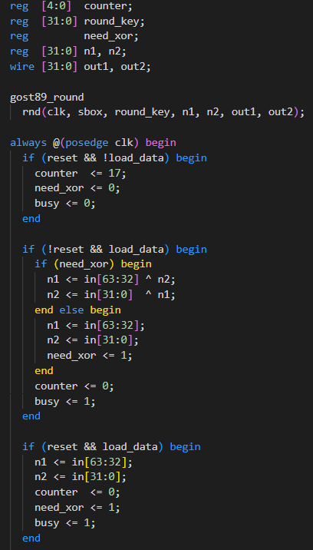
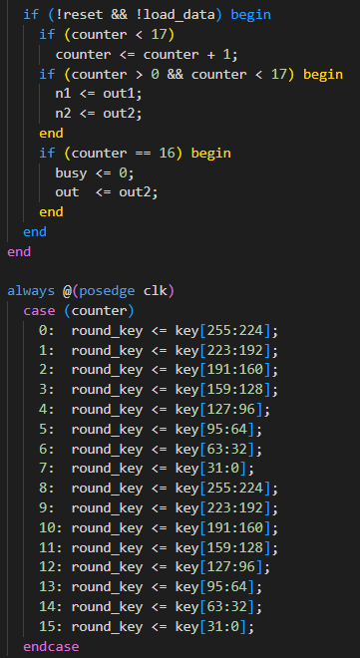
MAC – Message Authentication Code

Slide 23
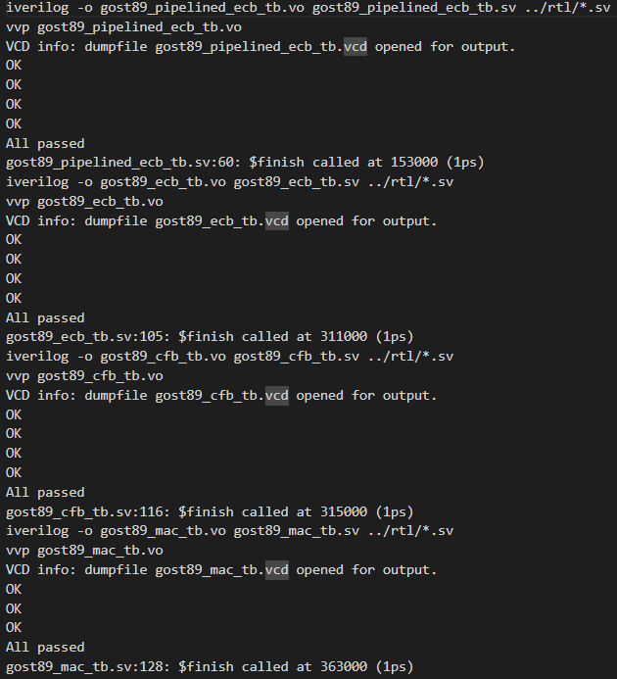
Make & Icarus Verilog
The creator of these modules has also created a makefile that runs all the testbenches and validates that the modules have no syntax errors
This makefile is designed to be ran with Icarus Verilog
So, the initial compilation and simulation is performed using Icarus Verilog
The results show that the tests pass, even after the format of the files has changed to System Verilog

Slide 24
Icarus Verilog & Vivado – System Verilog Support
However, I tried to add System Verilog syntax in the files and use this makefile, that only works with Icarus Verilog, and it would not run
It seems like not all System Verilog support has been implemented yet in Icarus Verilog
So, the rest of the simulations will be carried out in Vivado
A makefile for Vivado is possible, but it requires a TCL script and knowledge of the needed scripting to run a Vivado simulation
So, the simulations in Vivado will be performed manually, for each testbench separately

Slide 25
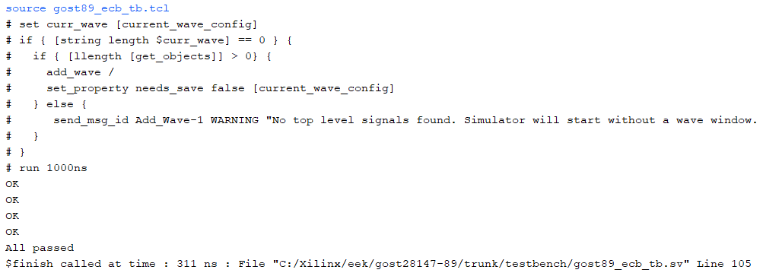
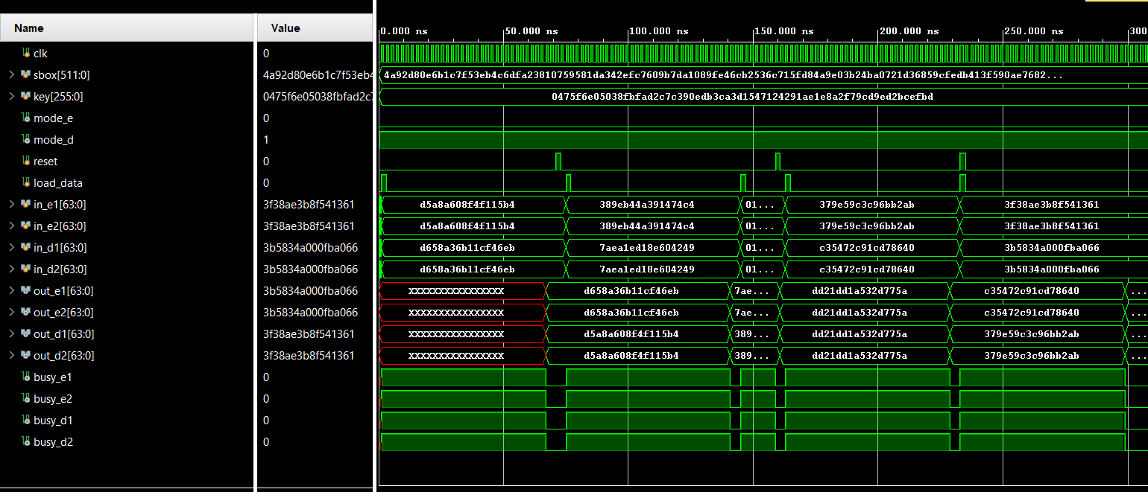
ECB – Vivado Simulation Result & Waveforms
s

Slide 26
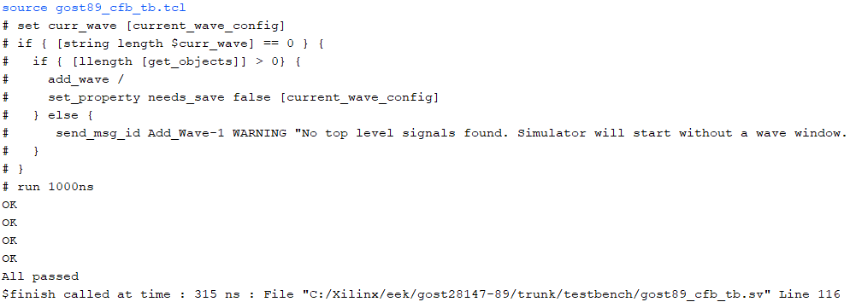
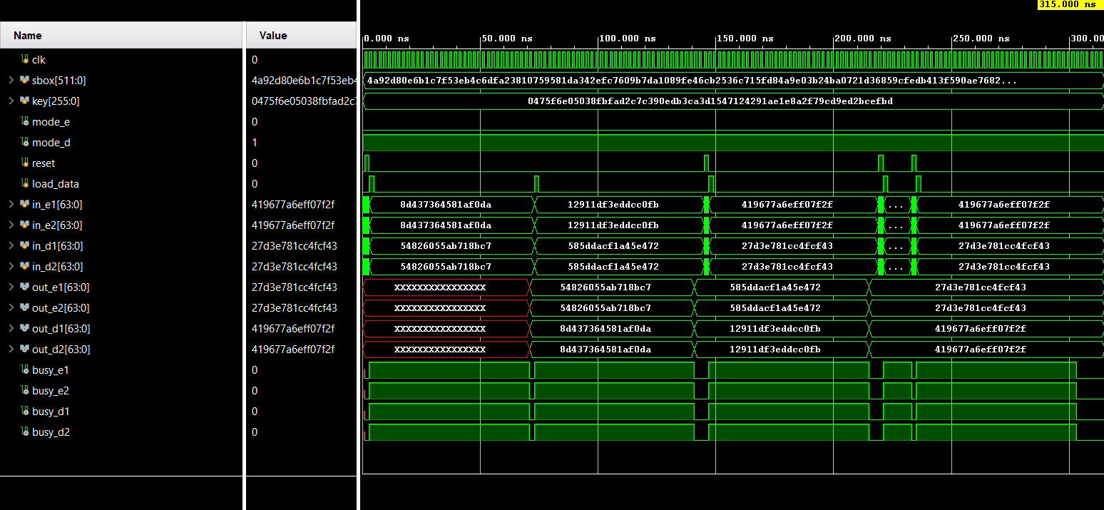
CFB – Vivado Simulation Result & Waveforms

Slide 27
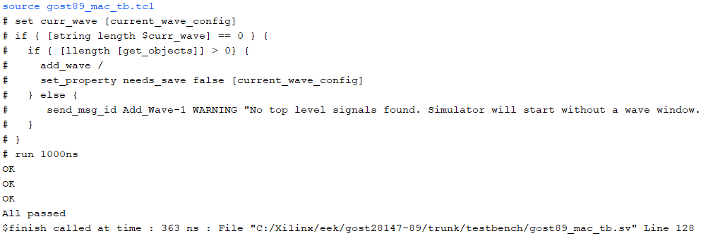
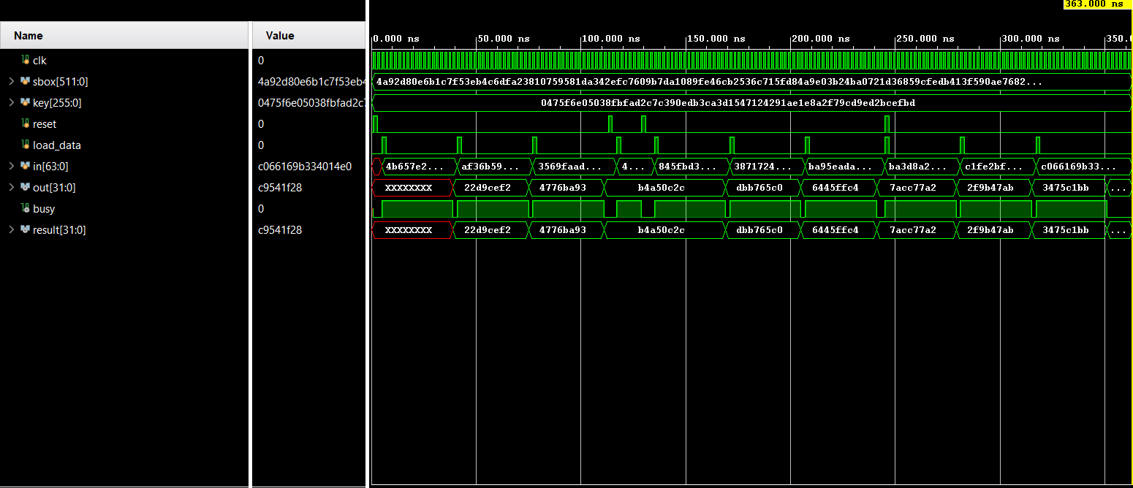
MAC – Vivado Simulation Result & Waveforms

Slide 28
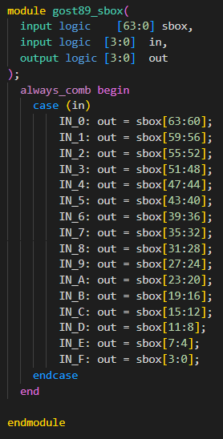
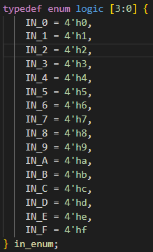
SV Changes - Sbox
We can add some System Verilog syntax in the new System Verilog modules, starting with the sbox module
The inputs and output can be declared with the keyword logic
The always block can be defined as always_comb, without the need of a sensitivity list
The cases can be represented with an enumeration
This may not constitute clearer code, but we apply this for the purposes of adding as many System Verilog features as possible

Slide 29
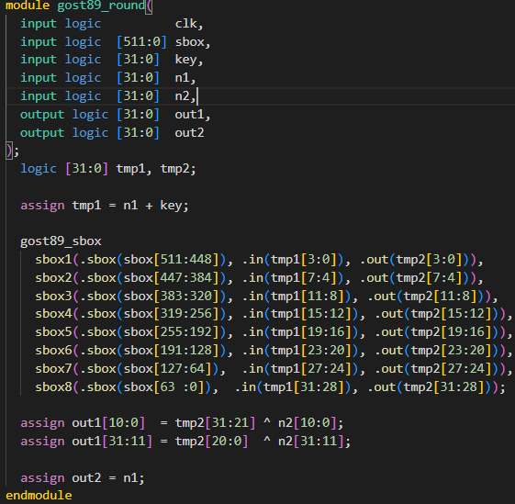
SV Changes - Round
Changes applied in the gost89_round module
The inputs and outputs, as well as the wires, can all be declared as logic
The module parameters can be passed by reference instead of by value
Not a System Verilog feature, but still an useful Verilog feature for more readable modules

Slide 30
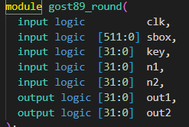

SV Changes - ECB
Changes applied in the gost89_ecb module
The inputs, outputs and regs can be declared as logic
The combinational always blocks can be declared with the keyword always_ff
The input/output of the round module that is instantiated can be expressed with the .* syntax for the logic that has the same name
So, for all the ports except round_key, which is key in the original module

Slide 31
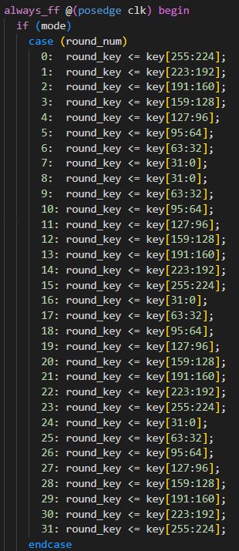
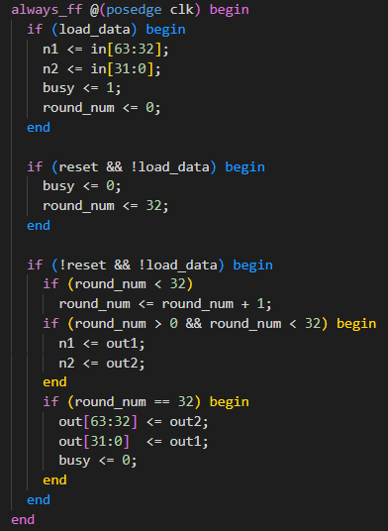
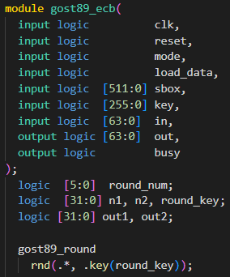
SV Changes - ECB

Slide 32
SV Changes - CFB
Changes applied in the gost89_cfb module
The inputs, outputs , wires and regs can be declared as logic
The combinational always blocks can be declared with the keyword always_ff
The ports of the ECB module that is instantiated can be referenced using the pass by reference syntax, but without the need to name ports with the same name

Slide 33
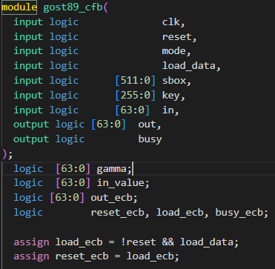
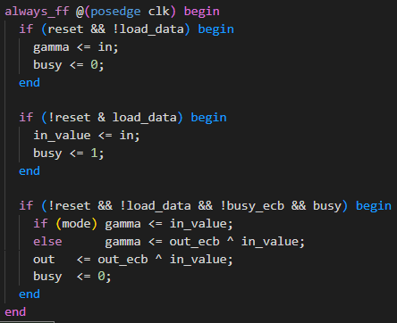
SV Changes - CFB

Slide 34
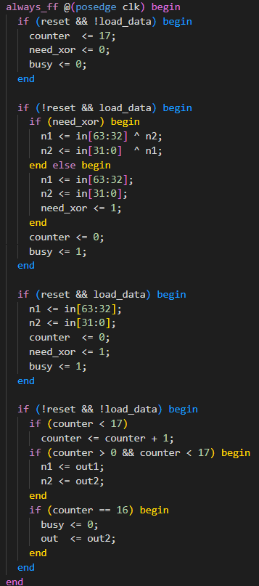
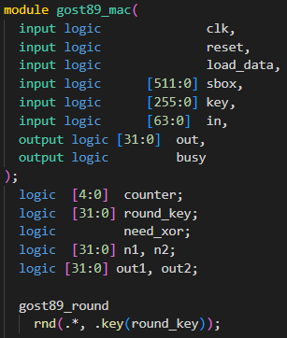
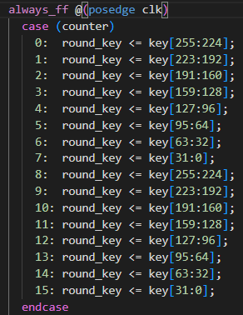
SV Changes - MAC

Slide 35
ECB - Testbench
The goal of the testbench for the ECB circuit is to verify that the encryption and decryption processes each produce the correct encrypted/decrypted word as output, and in the correct number of cycles
It checks these cases:
Normal usage: Load_data = 1 for one cycle to initiate the process
Usage after reset
Usage if a reset cancels out a previous process
Usage if reset and load are activated simultaneously
If each usage is correct, the message OK is printed
The module that supports both encryption and decryption, as well as the separate modules are tested for encryption and decryption

Slide 36
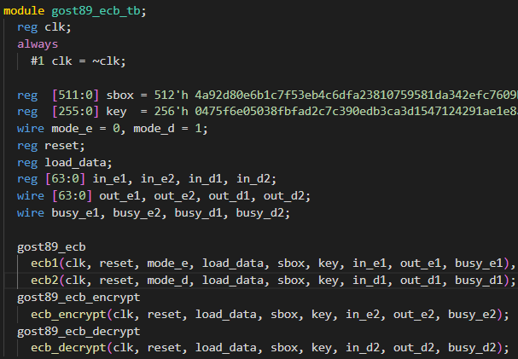
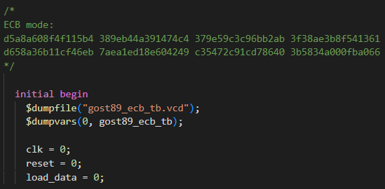
ECB - Testbench
Sbox and key purposefully cut off to fit in the screenshot

Slide 37
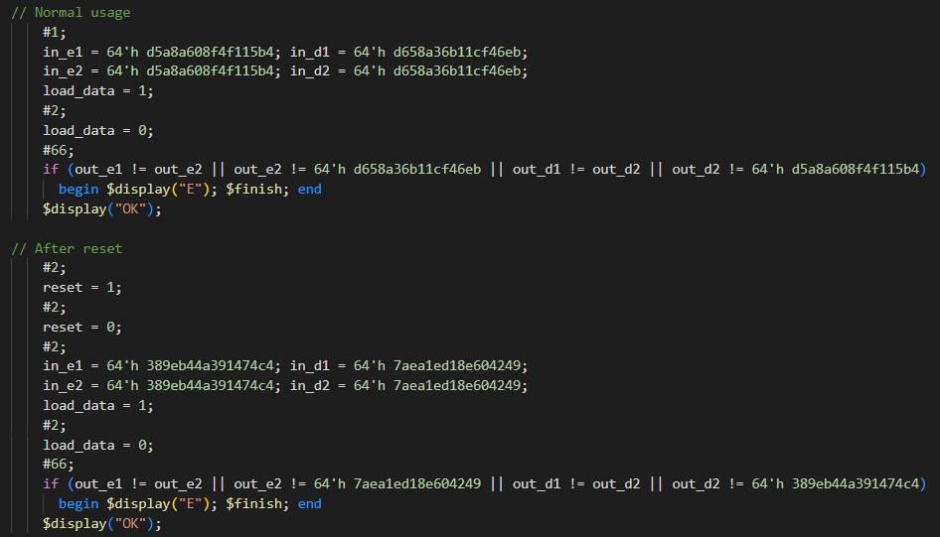
Normal usage & Usage after reset

Slide 38
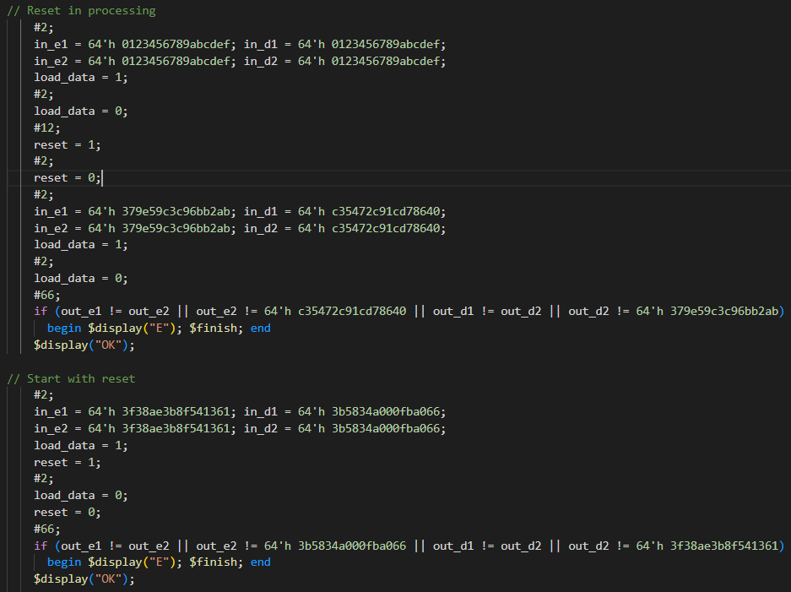
Reset in process & Start with reset

Slide 39
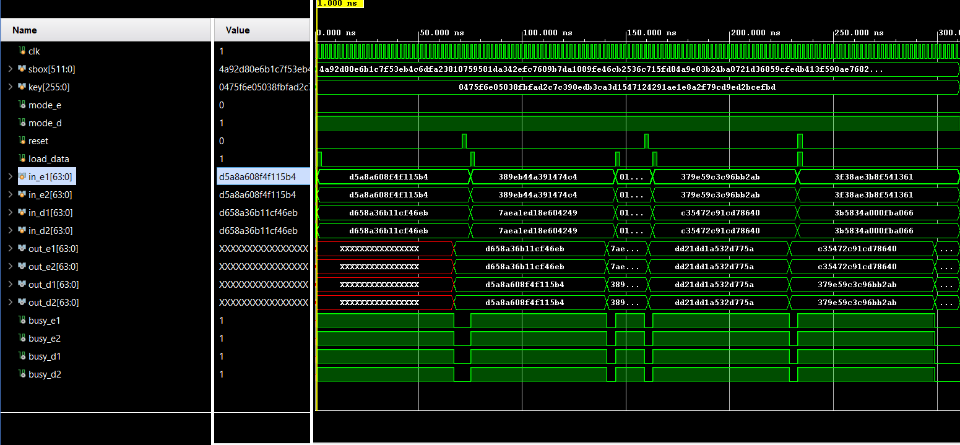
ECB - Waveforms
Case 1
Case 2
Case 3
Case 4

Slide 40
CFB & MAC Testbenches
The testbenches of CFB and MAC have similar structures
CFB checks 3 cases:
Normal usage
Usage after changing gamma
Usage after reset cancels out a previous process
MAC checks 3 cases:
Normal usage
Usage after reset
Usage after reset cancels out a previous process

Slide 41
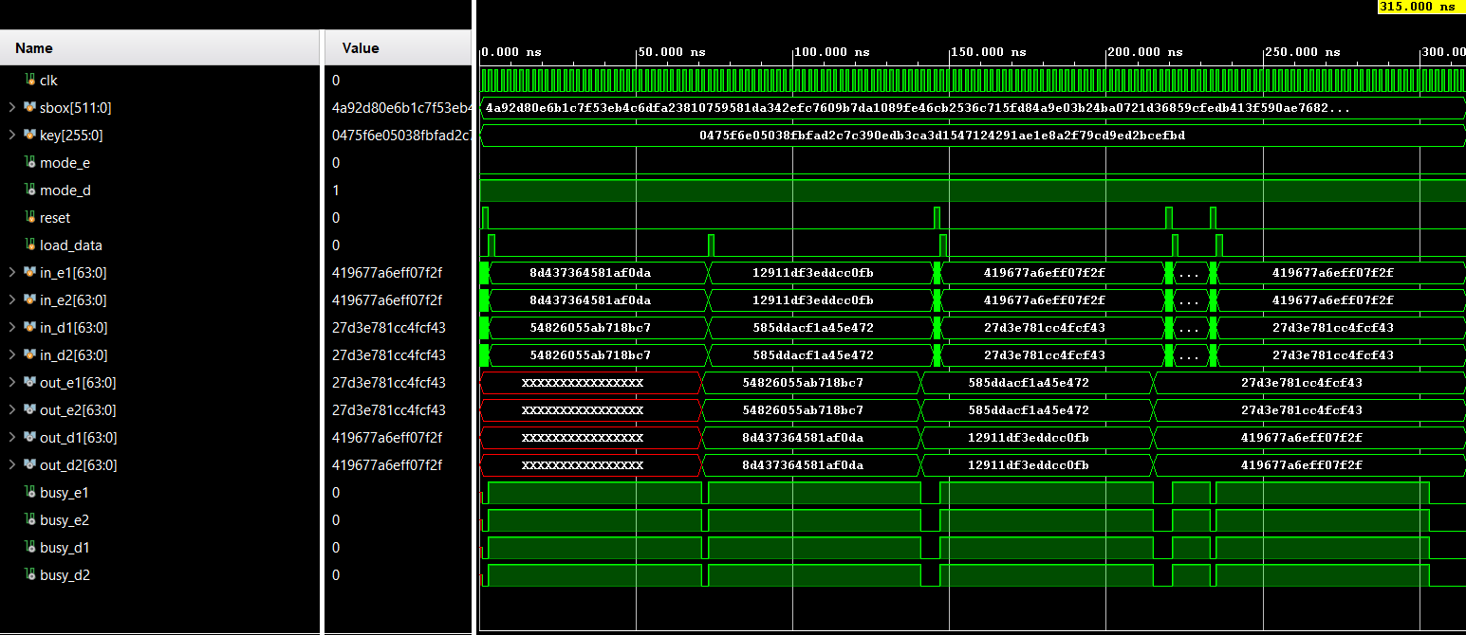
CFB - Waveforms
Case 1
Case 2
Case 3

Slide 42
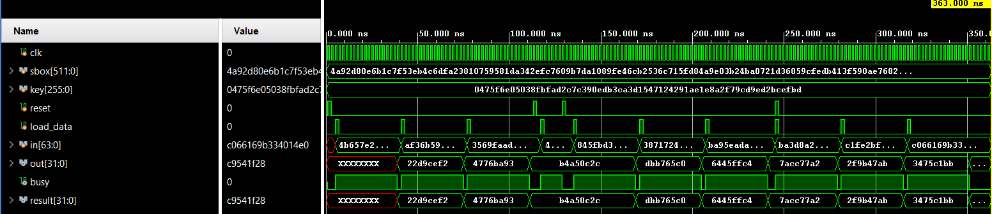
MAC - Waveforms
Case 1
Case 2
Case 3

Slide 43
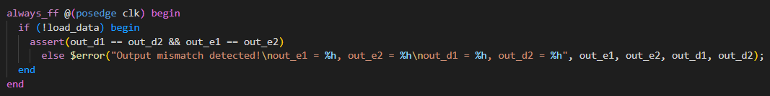
System Verilog Assertions - ECB
We can add some example System Verilog Assertions to help us verify the circuits
Will add only in ECB, but similar assertions can be applied to the other modules
SVA is supported by the newest version of Vivado, so the simulation will still be performed in Vivado
In the ECB testbench, we insert this simple assertion that checks if the encryption/decryption outputs are identical between the specialized encryption/decryption module and the module that can operate on both
If these values are different, an error is printed

Slide 44
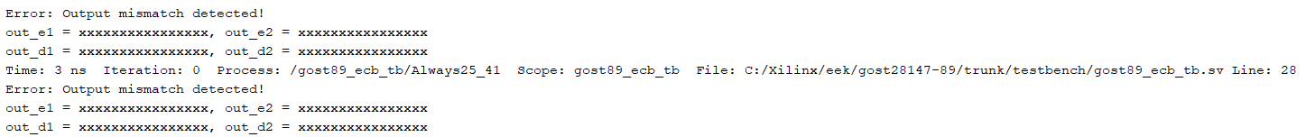
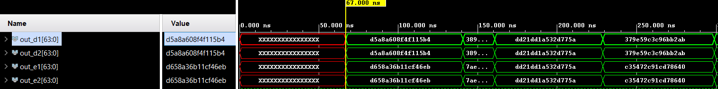
System Verilog Assertions - ECB
This assertion is not 100% correct, because it does not take the x values into consideration
Therefore it prints errors for each check up to the 67ns mark
It does not print errors after 67ns

Slide 45
System Verilog Assertions - ECB
This issue can be solved in multiple ways
One simple way is to replace the == equalities with === equalities
The === equality symbol tests 4-state logical equality, so if the two logic units are X, the equality will be true
Also, using the assert property syntax:

Slide 46
System Verilog Assertions - ECB
Another way to ignore the x values is to hardcode the time at which we start checking for the equalities
Represented usingng clock cycles
This is completed with ##34, meaning that the equalities will be checked only after 34 clock cycles have been completed, which translates to 68 time units

Slide 47
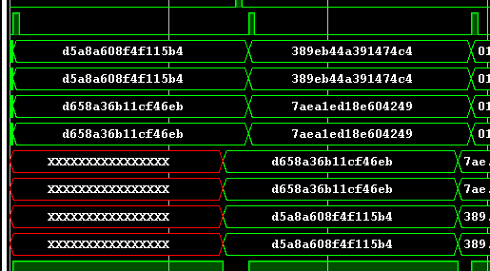




System Verilog Assertions - ECB
However, it is not a good practice to use hardcoded clock cycles, but rather to know on which logic unit the status of the variables depends

Slide 48
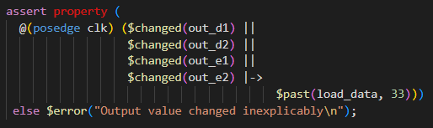
System Verilog Assertions - ECB
A way to implement that dependence on the past is by using the $past() syntax, along with $changed()
This assertion means that, if the variable out_d1 changed at any point, the load_data flag must have been active 33 cycles ago
If that is not true, an error is raised

Slide 49
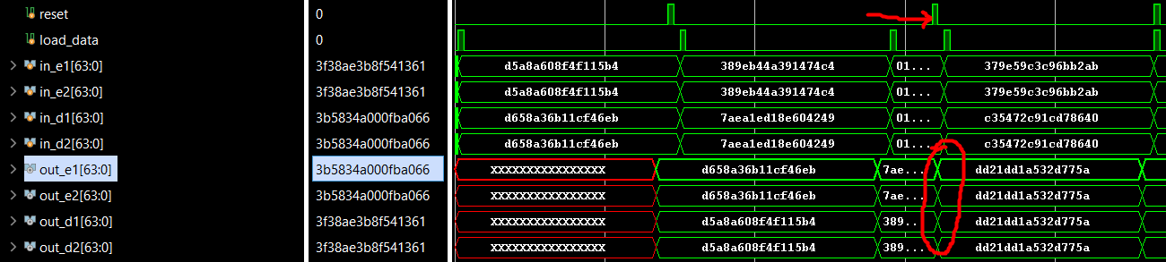
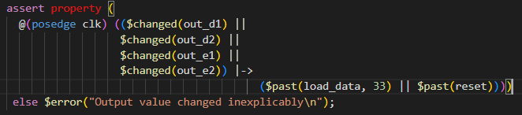
System Verilog Assertions - ECB
However, this assertion does not take a possible reset, which can itself change the output values, into consideration
This is settled with the assertion below, which uses $past(reset):

Slide 50
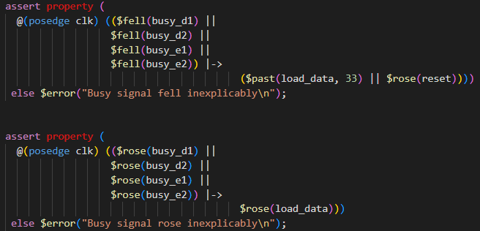
System Verilog Assertions - ECB
We can insert two more assertions that check that the busy signals receive their values appropriately
The first assertion checks that, if the busy signal fell, then this must have happened because either load_data was active 33 cycles ago, or a reset happened
The second assertion checks, if a busy signal rose, it is because load_data also rose at the same cycle

Slide 51
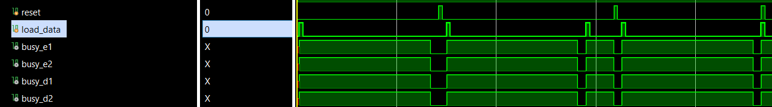
System Verilog Assertions - ECB
The checking of the busy signals could happen both ways
Check the past, like we did
Or check that the reset and load_data signals affect the busy signals after X cycles
The second method is tricker, because possible resets can happen at any cycle, so you have to constantly check if a reset rose

Slide 52
Conclusion
To conclude, the GOST module can benefit significantly from many features of the System Verilog language
Not only is the code more readable and friendly to the Verilog programmer, but it provides the user/programmer with many new verification tools in the form of SVA Assertions
I have only scratched the surface of the capabilities of System Verilog, just to demonstrate them for the purposes of this project
I apologize for a potential lack of general cryptography knowledge, as I have not taken any related course. I hope this presentation was clear and concise
All commits can be found in HeracrossTheGreek/eek_gost_Marios_Karagiannis_02976: This is the repository of my implementation of the GOST 28147-89 block cipher, in System Verilog language, for the purposes of the ECE425 - Testing and Verification of Digital Circuits (github.com)

